Slide 1
REAL ESTATE LEAD GENERATION & CONVERSION ANALYTICS
End-to-End Data Analytics Project
• Python • SQL • Excel • Power BI
• Lead generation, conversion, site visits and sales performance
1

Slide 2
Business Problem
• Identify which lead sources generate the highest volume of prospects.
• Measure how effectively leads move from enquiry to conversion.
• Understand property type, budget and site-visit patterns.
• Track sales value and conversion rate for better decisions.
2

Slide 3
Project Objectives
• Clean and prepare raw lead data.
• Perform exploratory analysis using Python.
• Use SQL for structured business analysis.
• Build Excel and interactive Power BI reporting.
• Convert analysis into business insights and recommendations.
3

Slide 4
Project Structure
• main.py — central project launcher.
• Python folder — analysis scripts and charts.
• SQL folder — database queries and analysis.
• Excel folder — cleaned data and Excel dashboard.
• Power BI folder — PBIX dashboard and report.
• Charts / Raw Data — supporting outputs and source data.
14

Slide 5
Tools & Project Workflow
• Raw Data → Python → SQL → Excel → Power BI
• Python supports cleaning and exploratory analysis.
• SQL supports repeatable business calculations.
• Excel validates and summarizes the data.
• Power BI provides interactive reporting for decision-making.
4

Slide 6
Dataset & Key Fields
• Lead ID and Lead Date — lead tracking and time analysis.
• Lead Source and Location — acquisition and geography.
• Property Type and Budget Range — customer demand.
• Call Attempts, Call Status and Follow-Up — sales activity.
• Site Visit, Lead Status and Sales Value — outcomes and revenue.
5

Slide 7
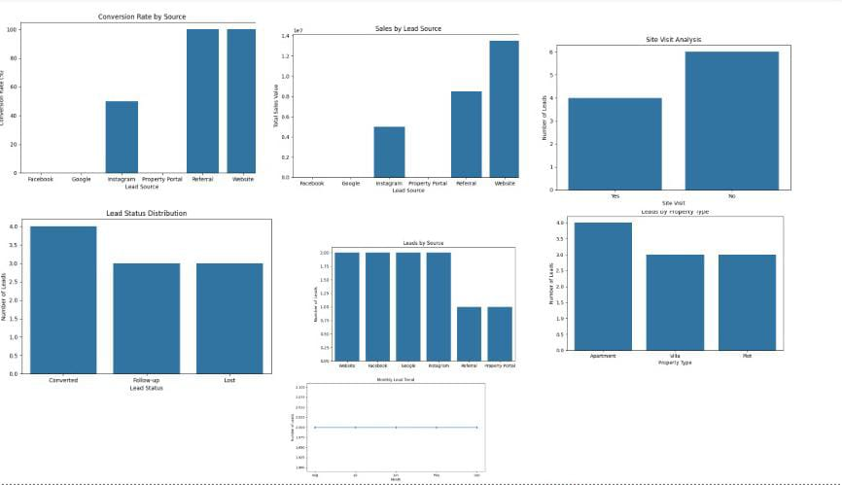
Python Analysis & Charts

Slide 8
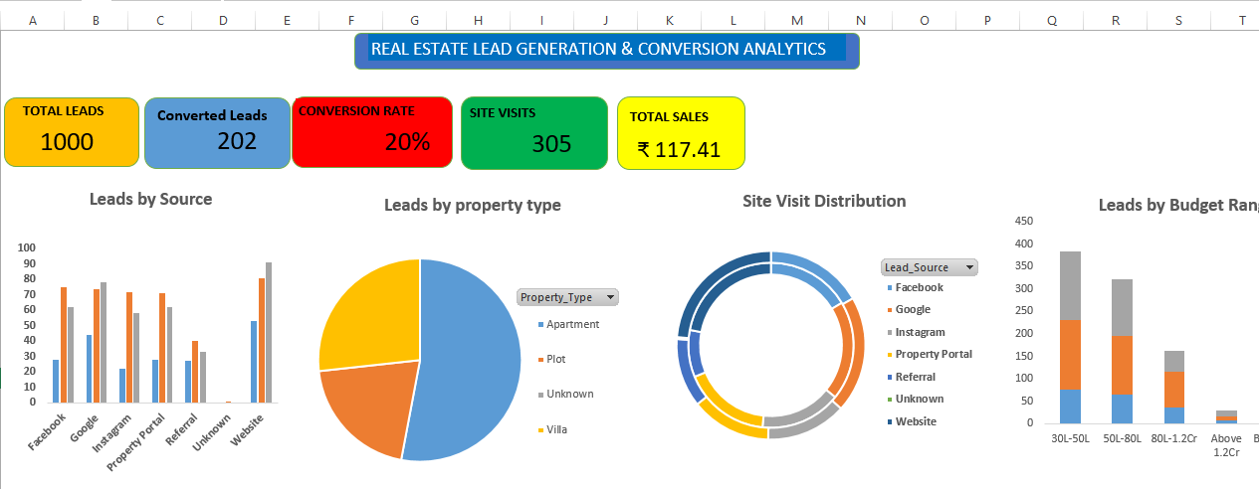
Excel Analysis & Dashboard
9

Slide 9
SQL Analysis
• Structured the lead data in MySQL for repeatable analysis.
• Used aggregation and filtering for lead, conversion, site-visit and sales metrics.
• Segmented results by source, property type, location and other dimensions.
• SQL results provide the analytical foundation for reporting.
8

Slide 10
Key Performance Indicators
• The dashboard combines acquisition volume, conversion, site visits and sales into one management view.
TOTAL LEADS
1K
CONVERTED LEADS
202
SITE VISITS
305
TOTAL SALES
2.15M
CONVERSION RATE
20.20%
10

Slide 11
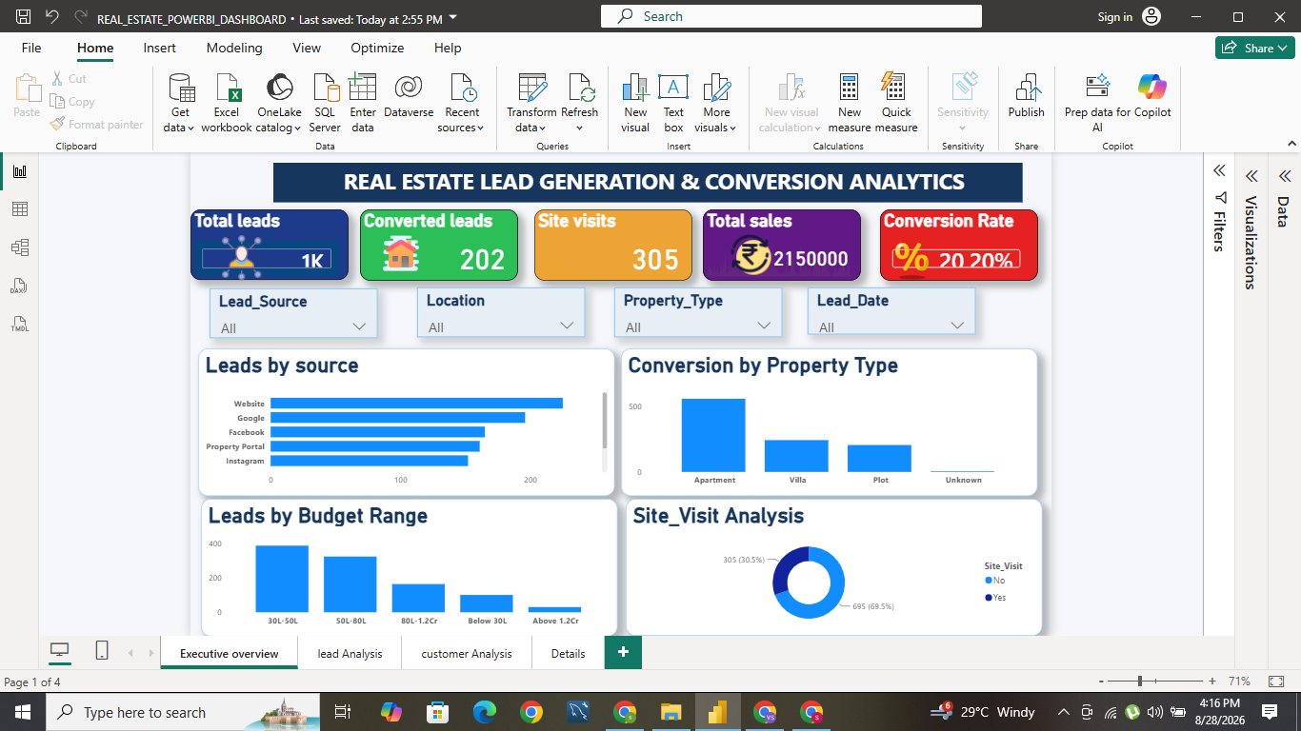
Power BI Executive Dashboard
Interactive overview with KPIs, slicers and analytical visuals
6

Slide 12
Business Insights
• Website is the leading visible source by lead volume in the executive dashboard.
• Apartment is the largest displayed property-type segment.
• 305 site visits are recorded from 1K total leads.
• 202 converted leads out of 1K corresponds to a 20.20% conversion rate.
• Sales value should be monitored together with conversion, not lead volume alone.
11

Slide 13
Business Recommendations
• Prioritize high-performing lead sources while testing lower-performing channels.
• Create targeted campaigns for high-demand property segments.
• Improve follow-up speed and consistency for unconverted leads.
• Track site-visit-to-conversion performance to find funnel bottlenecks.
• Monitor conversion rate and sales value together.
12

Slide 14
Interactive Dashboard Features
• Lead Source slicer — filter by acquisition channel.
• Location slicer — compare geographic performance.
• Property Type slicer — analyze demand by category.
• Lead Date slicer — explore performance across time.
• Selecting a segment updates relevant KPI and visual values.
13

Slide 15
Conclusion
• This project demonstrates an end-to-end data analytics workflow.
• Python supports data preparation and exploratory analysis.
• SQL supports structured business analysis.
• Excel provides a practical validation and reporting layer.
• Power BI transforms the results into an interactive decision-making dashboard.
16

